Slide 1


Part I
5. Quantitative Process Analysis
Dimitris SACHARIDIS
2023-2024

Slide 2
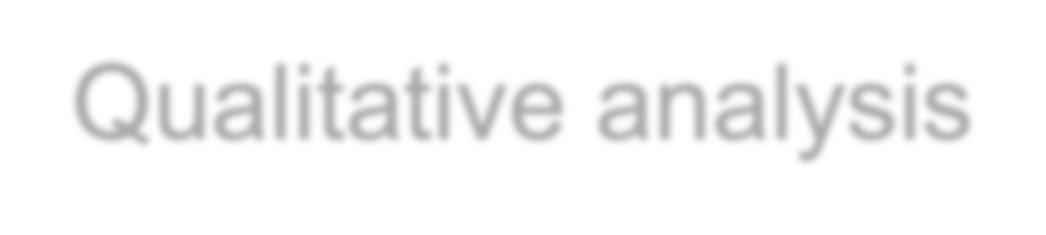
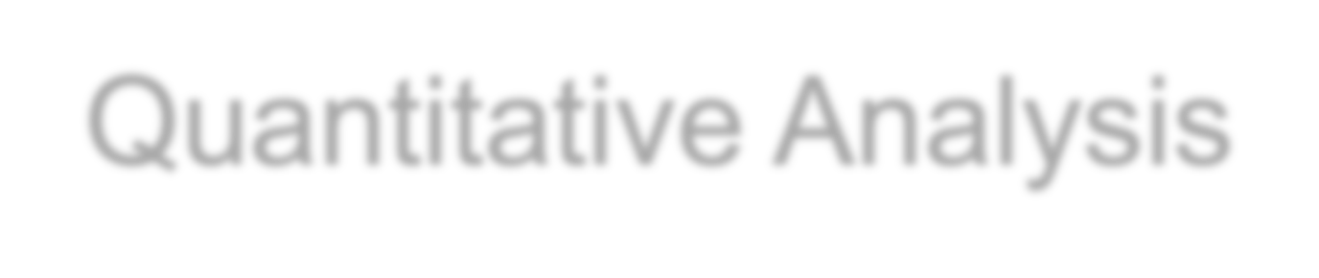
Process Analysis Techniques
Qualitative analysis
Value-Added & Waste Analysis
Root-Cause Analysis
Pareto Analysis
Issue Register
Quantitative Analysis
Flow analysis
Queuing analysis
Simulation

Slide 3
Flow Analysis
Flow analysis is a family of techniques to estimate the overall
performance of a process given some knowledge about the
performance of its tasks.
For example, using flow analysis we can calculate the average cycle
time of an entire process if we know the average cycle time of each
task and the probability of taking each
flow stemming from a decision gateway
Cycle time of a process is the average time it takes between the moment the process starts and the moment it completes. By extension, we say that the cycle time of a task is the average time it takes between the moment the task

Slide 4
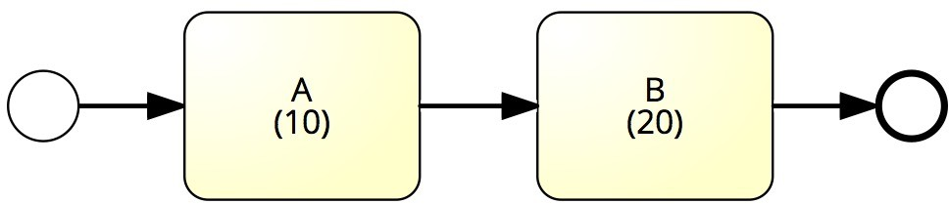
Sequence – Example
What is the average cycle time?
Cycle time = 10 + 20 = 30

Slide 5
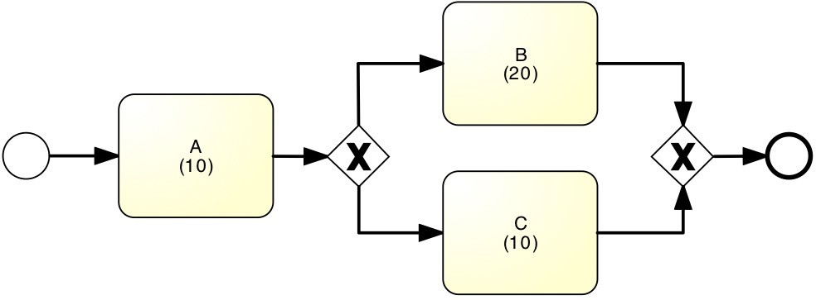
Example: Alternative Paths
What is the average cycle time?
50%
50%
Cycle time = 10 + (20+10)/2 = 25

Slide 6
Example: Alternative Paths
What is the average cycle time?
90%
10%
Cycle time = 10 + 0.9*20+0.1*10 = 29

Slide 7
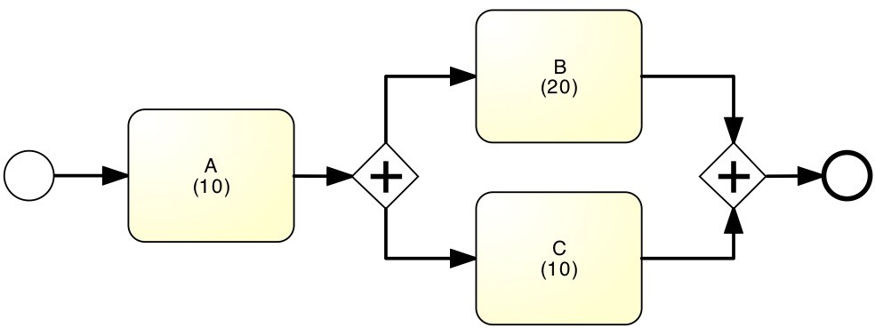
Example: Parallel paths
What is the average cycle time?
Cycle time = 10 + 20 = 30

Slide 8
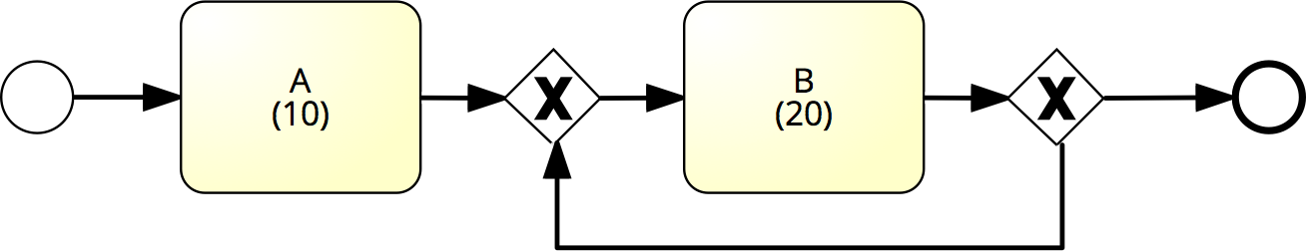
Example: Rework loop
What is the average cycle time?
100%
0%
Cycle time = 10 + 20 = 30

Slide 9
Example: Rework loop
What is the average cycle time?
0%
100%
Cycle time = ∞

Slide 10
Example: Rework loop
What is the average cycle time?
1%
99%
Cycle time = 10 + 20*(1+0.99+0.99²+0.99³+…) =
= 10 + 20/(1-0.99) = 2010

Slide 11
Example: Rework loop
What is the average cycle time?
80%
20%
Cycle time = 10 + 20/0.8 = 35

Slide 12
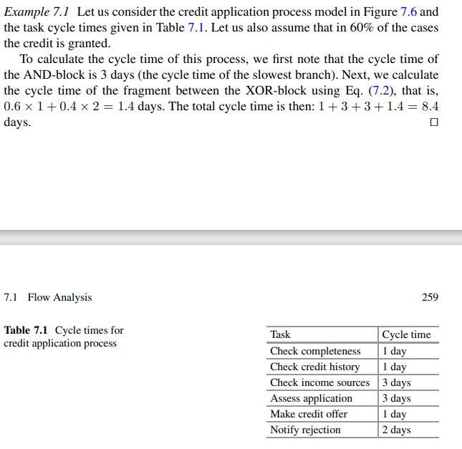
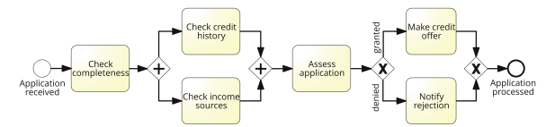

Slide 13




Process performance
Time
Process performance
Quality
Cost

Slide 14







_{Time measure}s_{s}tarts and the moment it completes.
cycle time of a process is the average time it takes between the moment the process starts and the moment it completes. By extension, we say that the cycle time of a task is the average time it takes between the moment the task
Time between start and completion of a process instance
Time taken by value-adding activities
Processing time
Cycle time
Waiting time
Time taken by non-value-adding activities

Slide 15





Cycle time efficiency
A cycle time efficiency close to 1 indicates that there is little room for improving the cycle time.
A ratio close to zero indicates that there is a significant amount of room for improving cycle time by reducing the waiting time.
Processing Time
Cycle Time Efficiency
Cycle Time

Slide 16



Cost measures
Cost of value- adding activities
Cost of a process instance
Processing cost
Per- Instance Cost
Cost of waste
Cost of non- value-adding activities

Slide 17


Typical components of cost
Material cost
Cost of tangible or intangible resources used per process instance
Resource cost
Cost of person-hours employed per process instance

Slide 18




Resource utilization
Time spent per resource on process work
Time available per resource for process work
Resource utilization
Resource utilization = 60%
➔ on average resources are idle 40% of their allocated time

Slide 19

Resource utilization vs. waiting time
Resource utilization
Waiting time
Typically, when resource utilization > 90%
➔ Waiting time increases steeply

Slide 20

Quality
Product quality
Defect rate
Delivery quality
On-time delivery rate
Cycle time variance
Customer satisfaction
Customer feedback score

Slide 21


Slide 22
Flow analysis
Process model
Process performance
Performance of each activity

Slide 23
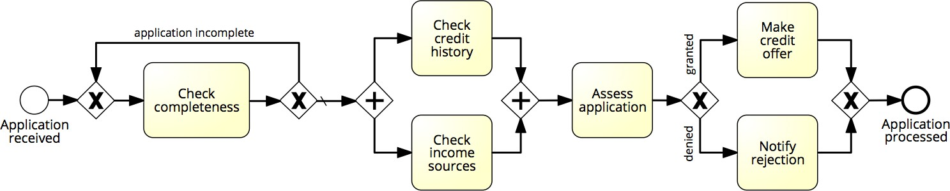

Flow analysis of cycle time
1 day
1 day
1 day
3 days
3 days
2 days
Cycle time = X days

Slide 24









Flow analysis equations for cycle time
T₁
T₂
T_{N}
CT = T₁+T₂+…+ T_{N}
...
p₁
T₁
p₂
T₂
CT = p₁*T₁+p₂*T₂+…+ p_{n}*T_{N}
p_{n}
...
T_{N}
T₁
CT = max(T₁, T₂,…, T_{N})
T₂
...
T_{N}
T
1 - r
CT = T / (1-r)
r

Slide 25

Flow analysis of cycle time
1 day
1 day
20%
60%
80%
1 day
3 days
40%
3 days
2 days
1/0.8
max(1,3)
3
0.6*1+0.4*2
Cycle time = 1.25 + 3 + 3 + 1.4 = 8.65 days
24

Slide 26
Flow analysis of processing time
0.5 hour
2 hours
20%
60%
80%
2 hours
2 hours
40%
3 hours
0.5 hours
2/0.8
max(0.5,3)
2
0.6*2+0.4*0.5
Processing time = 2.5 + 3 + 2 + 1.4 = 8.9 hours
Cycle time efficiency = 8.9 hours / 8.65 days = 12.9%
25

Slide 27
Flow analysis of cost
5 €
20 €
20%
60%
80%
20 €
20 €
40%
30 €
5 €
20/0.8
5 + 30
20
0.6*20+0.4*5
Cost = 25 + 35 + 20 + 14 = 94 €
26

Slide 28
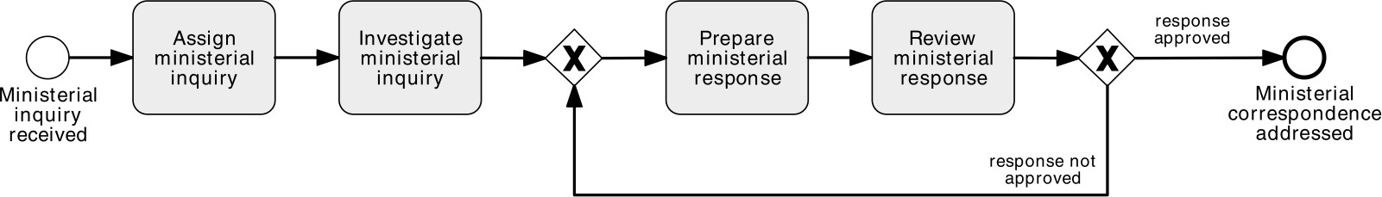
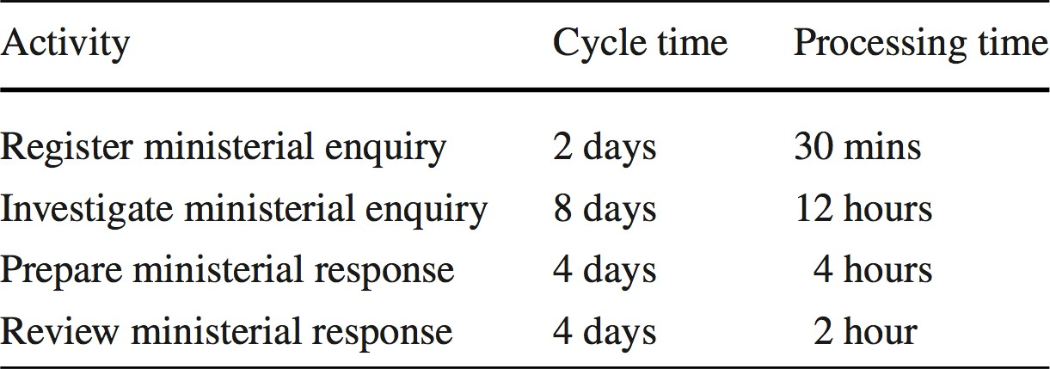
Exercise: Calculate the Cycle Time Efficiency

Slide 29
Flow analysis: scope and limitations
Flow analysis for cycle time calculation
Other applications:
Calculating cost-per-process-instance
Calculating error rates at the process level
Estimating capacity requirements
But it has its limitations…

Slide 30
Flow Analysis Limitation
Equations for calculating processing and cycle time only work in the case of block-structured process models. In particular, we cannot use these equations to calculate the cycle time of an unstructured process model
A more fundamental roadblock faced by analysts when applying flow analysis is the fact that they first need to estimate the average cycle time of each task in the process model. There are at least two approaches to address this obstacle. The first one is based on interviews or observation. In this approach, analysts interview the stakeholders involved in each task or they observe how the stakeholders work during a given day or period of time. A second approach is to collect logs from the information systems used in the process. For example, if a task “Approve purchase requisition” is performed via a Web portal.
A more fundamental limitation of flow analysis is that it does not take into account the fact that a process behaves differently depending on the load. Intuitively, the cycle time of a process for handling insurance claims would be much slower if the insurance company is handling thousands of claims at once, due for example to a recent natural disaster such as a storm, versus the case where the load is low and the insurance company is only handling a hundred claims at once. When the load goes up and the number of resources (e.g., claim handlers) remains relatively constant, it is clear that the waiting times are going to be longer. This is due to a phenomenon known as resource contention. Resource contention occurs when there is more work to be done than resources available to perform the work, like for example more claims than insurance claim handlers. In such scenarios, some tasks will be in waiting mode until one of the necessary resources is freed up. Flow analysis does not directly inform us about the effects of increased resource contention.

Slide 31
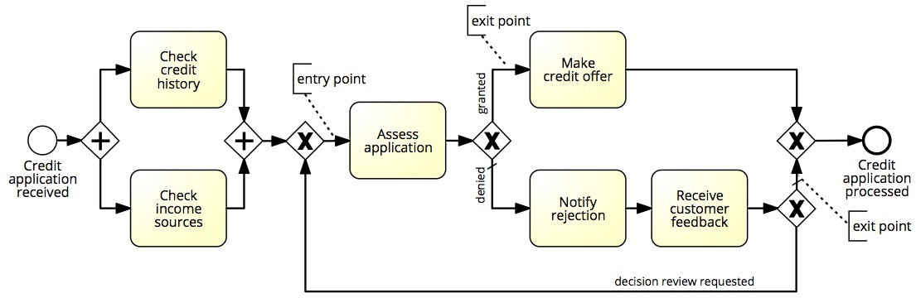
Limitation 1: Not all Models are Structured

Slide 32
Limitation 2: Fixed arrival rate capacity
Cycle time analysis does not consider:
The rate at which new process instances are created (arrival rate)
The number of available resources
Higher arrival rate at fixed resource capacity
➔ high resource contention
➔ higher activity waiting times (longer queues)
➔ higher activity cycle time
➔ higher overall cycle time
The slower you are, the more people have to queue up…
and vice-versa

Slide 33


Process Analysis Techniques
Qualitative analysis
Value-Added & Waste Analysis
Root-Cause Analysis
Pareto Analysis
Issue Register
Quantitative Analysis
Flow analysis
Queuing analysis
Simulation

Slide 34


Why flow analysis is not enough?
Queuing analysis and simulation address these limitations and have a broader applicability
Flow analysis does not consider waiting times due to resource contention
32

Slide 35
Exercise
A fast-food restaurant receives on average 1200 customers per day (between 10:00 and 22:00). During peak times (12:00-15:00 and 18:00-21:00), the restaurant receives around 900 customers in total, and 90 customers can be found in the restaurant (on average) at a given point in time. At non-peak times, the restaurant receives 300 customers in total, and 30 customers can be found in the restaurant (on average) at a given point in time.
What is the average time that a customer spends in the restaurant during peak times?
What is the average time that a customer spends in the restaurant during non-peak times?
The restaurant plans to launch a marketing campaign to attract more customers. However, the restaurant’s capacity is limited and becomes too full during peak times. What can the restaurant do to address this issue without investing in extending its building?

Slide 36
Cycle Time & Work-In-Progress
WIP = (average) Work-In-Process
Number of cases that are running – in other words: cases that have started but not yet completed.
Example: the number of active orders in an order-to-cash process.
WIP is a form of waste
Little’s Formula: L = λ·W
L = WIP
λ = arrival rate (number of new cases per time unit)
W = cycle time

Slide 37
Queueing Theory
Queueing theory is a collection of mathematical techniques to analyze systems that have resource contention.
Queueing theory gives us techniques to analyze important parameters of a queue such as the expected length of the queue or the expected waiting time of an individual case in a queue.
In basic queueing theory, a queueing system consists of one or multiple queues and a service that is provided by one or multiple servers. The elements inside a queue are called jobs or customers, depending on the specific context.
For example, in the case of a supermarket, the service is that of checking out. This service is provided by multiple cashiers (the servers). Meanwhile, in the case of a bank office, the service is to perform a banking transaction, the servers are tellers, and there is generally a single queue that leads to multiple servers (the tellers). These two examples illustrate an important distinction between multi-line (i.e., multi-queue) queueing systems (like the supermarket) and single-line queueing systems (like the bank office).
In the two models we will be presenting there is a single queue (single-line queueing system). Instances arrive at a given average arrival rate λ. This is the same concept of arrival rate that we discussed above when presenting Little’s law. For example, we can say that customers arrive to the bank office at a mean rate of 20 per hour. This implies that, on average, one customer arrives every 3 min ( 1 20 h). This latter number is called the mean inter-arrival time. We observe that if λ is the arrival rate per time unit, then 1/λ is the mean inter-arrival time. It would be illusory to think that the time between the arrival of two customers at the bank office is always 3 min. This is just the mean value. In practice, customers arrive independently from one another.
so the time between the arrival of one customer and the arrival of the next customer is completely random. Such an arrival process is called a Poisson process

Slide 38
M/M/1 and M/M/c
In the queueing theory field, a single-queue system is called an M/M/1 queue5 if the inter-arrival times of customers follow an exponential distribution, the processing times follow an exponential distribution, there is one single server and instances are served on a First-In-First-Out (FIFO) basis. In the case of M/M/1 queue, we also assume that when an instance arrives it enters the queue and it stays there until it is taken on by the server.
If the above conditions are satisfied, but there are multiple servers instead of a single server, the queueing system is said to be M/M/c, where c is the number of servers. For example, a system is M/M/5 if the inter-arrival times of customers follow an exponential distribution, the processing times follow an exponential distribution, and there are 5 servers at the end of the queue. The “M” in this denomination stands for “Markovian”, which is the name given to the assumptions that inter-arrival times and processing times follow an exponential distribution. Other queueing models exist that make different assumptions

Slide 39
The previous discussion, an M/M/1 queue or M/M/c queue can be defined by means of the following parameters:
• λ is the mean arrival rate per time unit. The mean inter-arrival time is then 1/λ. For example, λ = 5 means that there are 5 arrivals per hour and this entails that the mean inter-arrival time between two consecutive instances is 1/5 h, that is 12 min.
• μ is the theoretical capacity per server (i.e., theoretical capacity per resource) or in other words, the number of instances that a server can execute per time unit. For example, μ = 6 means that 6 instances are served per hour, which means that one instance is served in 10 min (on average).6
• In the case of M/M/c, the number of servers is c. Given parameters λ and μ, we defined in Section 7.1.5 the resource utilization ρ = λ/μ. In the above example, the resource utilization is 5/6 = 83.34%.
A system with a resource utilization of more than 100% is unstable, which means that the queue will become longer and longer forever because the server cannot cope with all the demand. In fact, even a system with a resource utilization close to 100% is unstable because of the randomness with which new instances arrive and the variability in the processing times per instance
In the case of an M/M/c system, the resource utilization is λ cμ since the system consists of a pool of resources that can collectively handle instances at a rate of cμ. For example, if the system has 2 servers and each server can handle 2 instances per hour, the system can handle 4 instances per hour. If instances arrive at a mean rate of 3 per hour, the resource utilization of the system is 3/4 = 75%.

Slide 40
Given an M/M/1 or M/M/c system, queueing theory allows us to calculate the following parameters:
• Lq is the average number of instances in the queue.
• Wq is the average time one instance spends in the queue.
• W is the average time one instance spends in the entire system. This includes both the time the instance spends in the queue but also the time it spends being serviced.
• L is the average number of instances in the system (i.e., the Work-In-Process referenced in Little’s law)

Slide 41
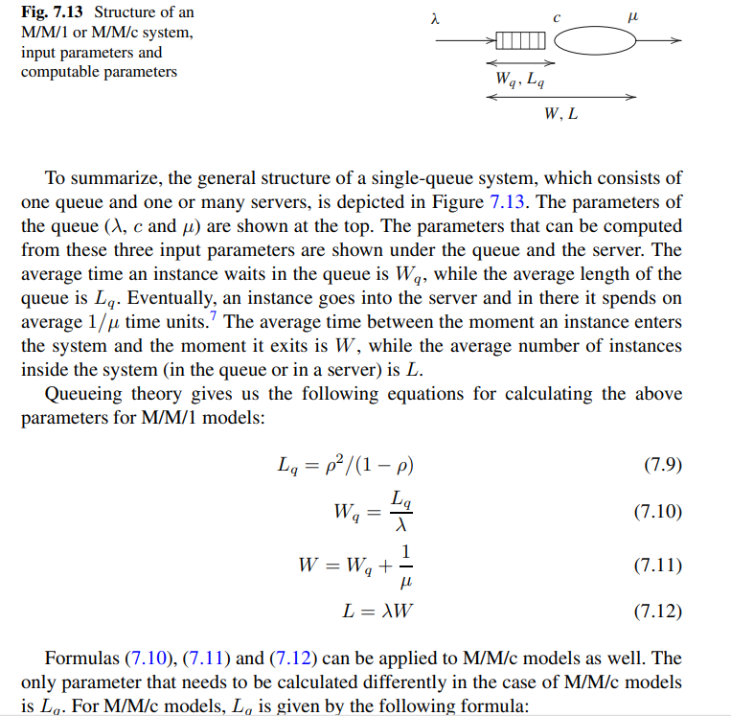

Slide 42
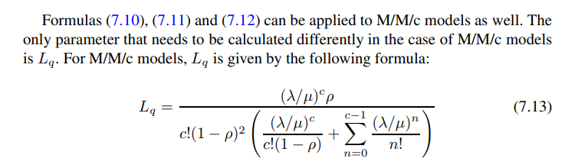

Slide 43
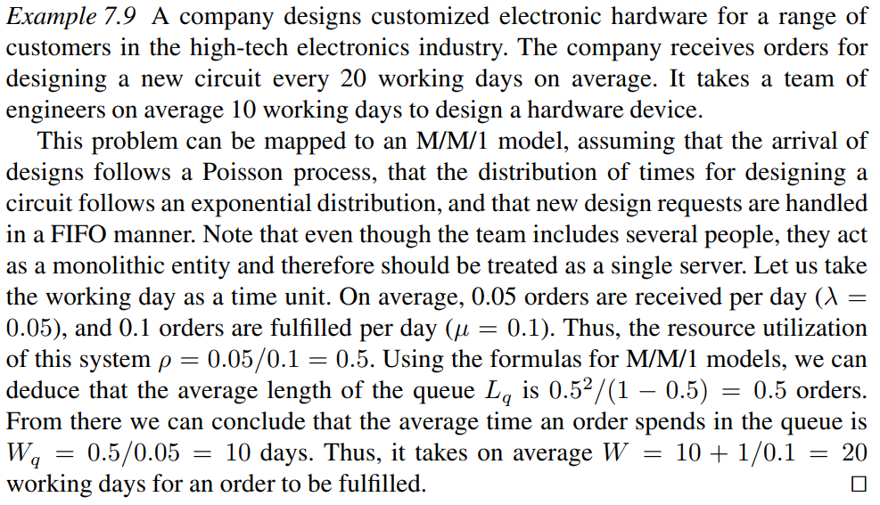

Slide 44
Queuing Analysis
Capacity problems are common and a key driver of process redesign
Need to balance the cost of increased capacity against the gains of increased productivity and service
Queuing and waiting time analysis is particularly important in service systems
Large costs of waiting and/or lost sales due to waiting
Prototype Example – ER at a Hospital
Patients arrive by ambulance or by their own accord
One doctor is always on duty
More patients seeks help ⇒ longer waiting times
Question: Should another MD position be instated?
© Laguna & Marklund
35

Slide 45
Delay is Caused by Job Interference
If arrivals are regular or sufficiently spaced apart, no queuing delay occurs
Arrival Times
1
2
3 4
Deterministic traffic
2
Departure Times
Time
1
3
4
Arrival Times
1
2
3
4
Variable but spaced apart traffic
Time
1
2
Departure Times
3
4
© Dimitri P. Bertsekas
36

Slide 46
Job Size Variation Causes Interference
Deterministic arrivals, variable job sizes
Time
Queuing Delays
© Dimitri P. Bertsekas
37

Slide 47
Burstiness Causes Interference
Deterministic job size, variable arrivals
1
2
3
4
Bursty Traffic
Time
1
2
3
4
Queuing Delays
© Dimitri P. Bertsekas
38

Slide 48


High Utilization Exacerbates Interference
The queuing probability increases as the load increases
Utilization close to 100% is unsustainable → too long queuing times
Time
Queuing Delays
© Dimitri P. Bertsekas
39

Slide 49
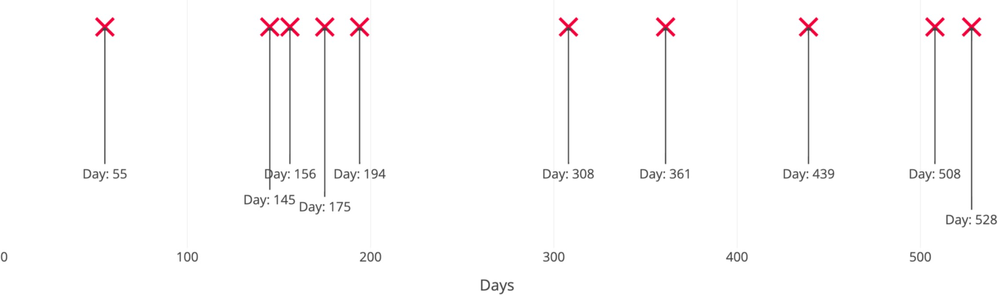
The Poisson Process
A Poisson Process is a model for a series of discrete events where
the average time between events is known, but the exact timing of events is random.
The arrival of an event is independent of the event before
Example Poisson Process with average time between events of 60 days
https://towardsdatascience.com/the-poisson-distribution-and-poisson-process-explained-4e2cb17d459
40

Slide 50
The Poisson Process
Common arrival assumption in many queuing and simulation models
has a single parameter:
λ is the arrival rate (number of events per time unit)
Expected number of events in a time interval of length T is λT
if the average time between events is 60 minutes, what is λ?
λ = 1/60

Slide 51
The Poisson Process
Key property: no memory
The fact that a certain event has not happened tells us nothing about how long it will take before it happens
Let T represent the random variable denoting the time elapsed since the last event (=inter-arrival time)
P( T>t+s | T>s ) = P(T>t)
If we’ve already waited s minutes without seeing an event, the probability that an event won’t occur in the next t minutes is the same as if we hadn’t already waited s minutes
The times between arrivals are independent, identically distributed and follow the exponential distribution
P (T > t) = e^{-λt}

Slide 52
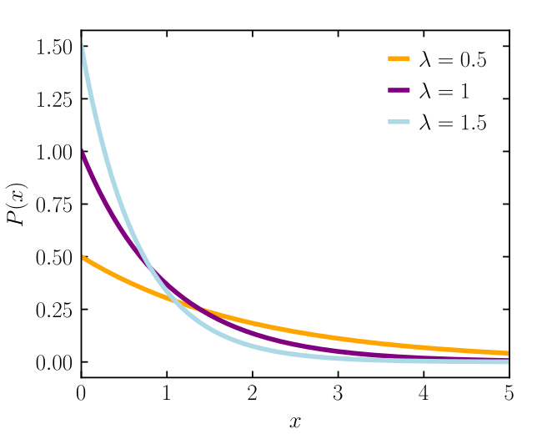
Probability Density Function of Exponential Distribution

Slide 53

Queuing theory: basic concepts
waiting
service
arrivals
λ
c
Basic characteristics:
λ (mean arrival rate) = average number of arrivals per time unit
μ (mean service rate) = average number of jobs that can be handled by one server per time unit:
c = number of servers
© Wil van der Aalst

Slide 54

Queuing theory concepts (cont.)
λ
c
W_{q}, L_{q}
W, L
Given λ, μ, and c, we can calculate :
ρ = resource utilization
W_{q} = average time a job spends in queue (i.e., waiting time)
W = average time in the “system” (i.e., cycle time)
L_{q} = average number of jobs in queue (i.e., length of queue)
L = average number of jobs in system (i.e., Work-in-Progress)
© Wil van der Aalst
45

Slide 55

M/M/1 queue
λ
1
Wq,Lq
W,L
Assumptions:
time between arrivals and processing time follow an exponential distribution
1 server (c = 1)
FIFO
_{ρ} Capacity Demand λ
Available Capacity μ
L=ρ/(1- ρ)
W=L/λ=1/(- λ)
Lq= ρ²/(1- ρ) = L-ρ
Wq=Lq/λ= λ /( (- λ))
© Laguna & Marklund

Slide 56
M/M/c queue
Now there are c servers in parallel, so the expected capacity per time unit is then c*
_{ρ} Capacity Demand λ
Available Capacity c*
Little’s Formula ⇒ Wq=Lq/λ
W=Wq+(1/)
Little’s Formula ⇒
L=λW
© Laguna & Marklund

Slide 57
Tool Support
For M/M/c systems, the exact computation of Lq is rather complex, but…
these calculations can be done by a queuing theory calculator:
http://www.supositorio.com/rcalc/rcalclite.htm
https://qsa.inf.unideb.hu/prod/frontend/schemes/
48

Slide 58

Example – ER at County Hospital
Situation
Patients arrive according to a Poisson process with intensity λ (⇔ the time between arrivals is exp(λ) distributed)
The service time (the doctor’s examination and treatment time of a patient) follows an exponential distribution with mean 1/ (=exp() distributed)
⇒ The ER can be modeled as an M/M/c system where c = the number of doctors
Data gathering
⇒ λ = 2 patients per hour
⇒ = 3 patients per hour
Question
– Should the capacity be increased from 1 to 2 doctors?
© Laguna & Marklund

Slide 59
Queuing Analysis – Hospital Scenario
Interpretation
To be in the queue = to be in the waiting room
To be in the system = to be in the ER (waiting or under treatment)
Characteristic | One doctor (c=1) | Two Doctors (c=2)
ρ | 2/3 | 1/3
Lq | 4/3 patients | 1/12 patients
L | 2 patients | 3/4 patients
Wq | 2/3 h = 40 minutes | 1/24 h = 2.5 minutes
W | 1 h | 3/8 h = 22.5 minutes
Is it warranted to hire a second doctor ?
© Laguna & Marklund

Slide 60
Limitations of basic queuing theory
The basic queueing analysis techniques presented above allow us to estimate waiting times and queue lengths based on the assumptions that inter-arrival times and processing times follow an exponential distribution. When these parameters follow different distributions, one needs to use different queueing models.
more fundamental limitation of the techniques introduced in this section is that they only deal with one task at a time. When we have to analyze an entire process that involves several tasks, events, and resources, these basic techniques are not sufficient.

Slide 61
Process Simulation
Versatile quantitative analysis method for
As-is analysis
What-if analysis
In a nutshell:
Run a large number of process instances
Gather performance data (cost, time, resource usage)
Calculate statistics from the collected data

Slide 62
Processs Simulation
The idea is to use the process simulator for generating a large number of
hypothetical instances of a process, executing these instances step-by-step, and
recording each step in this execution. The output of a simulator then includes the
logs of the simulation as well as statistics of cycle times, average waiting times, and
average resource utilization.

Slide 63
Anatomy of Process Simulation
During a process simulation, the tasks in the process are not actually executed.
Instead, the simulation of a task proceeds as follows.
When a task is ready to be executed, a so-called work item is created and the simulator first tries to find a resource to which it can assign this work item. If no resource able to perform the work item is available, the simulator puts the work item in waiting mode until a suitable resource becomes available. Once a resource is assigned to a work item, the simulator determines the duration of the work item by drawing a random number according to the probability distribution of the task processing time. This probability distribution and the corresponding parameters need to be defined in the simulation model.
Once the simulator has determined the duration of a work item, it puts the work item in sleeping mode for that duration. This sleeping mode simulates the fact that the task is being executed. Once the time interval has passed (according to the simulation clock), the work item is declared to be completed and the resource that
was assigned to it becomes available.
In reality, the simulator does not effectively wait for tasks to come back from their sleeping mode. For example, if the simulator determines that the duration of a work item is 2 days and 2 h, it will not wait for this amount of time to pass by. You can imagine how long a simulation would take if that was the case. Instead, simulators use smart algorithms to complete the simulation as fast as possible. Modern business process simulators can effectively simulate thousands of process instances and tens of thousands of work items in a matter of seconds.

Slide 64
For each work item created during a simulation, the simulator records the identifier of the resource that was assigned to this instance as well as three timestamps:
• The time when the task was ready to be executed.
• The time when the task was started, meaning that it was assigned to a resource.
• The time when the task completed.
Using this information, simulator can then determine average waiting time and resource utilization.

Slide 65
Input for Process Simulation
Following information needs to be specified for each task in the process model in order to
simulate it:
1. The probability distribution for the processing time of each task.
2. Other performance attributes for the task such as cost and added-value produced by the task.
3. The resource pool that is responsible for performing the task. In the loan application process, there are three resource pools: the claim handlers, the clerks and the managers. For each resource pool, we need to specify its size (e.g., the number of claim handlers or the number of clerks) and optionally their cost per
time unit (e.g., the hourly cost of a claims handler). If we specify the cost per time unit for every resource pool, the simulation will calculate the mean labor cost per case in addition to calculating cycle times and waiting times
Finally, in order to run a simulation, the analyst additionally needs to specify at
least the following:
• The mean inter-arrival time and its associated probability distribution.
• The starting date and time of the simulation (e.g., “11 Nov. 2017 at 8:00”).
• One of the following:
– The end date and time of the simulation. If this option is selected, the simulation will stop producing more process instances once the simulation clock reaches the end time.
– The real-time duration of the simulation (e.g., 7 days, 14 days). In this way, the end time of the simulation can be derived by adding this duration to the starting time.
– The required number of process instances to be simulated (e.g., 1,000). If this option is selected, the simulator generates process instances according to the arrival rate until it reaches the required number of process instances. At this point, the simulation stops. Some simulators will not stop immediately, but will allow the active process instances to complete before stopping the simulation.

Slide 66
Common probability distributions for processing time of a task in the context of process simulation include:
• Fixed.
This is the case where the processing time of the task is the same for all instances of execution taking place.
It is rare to find such tasks because most tasks,
especially those involving human resources, would exhibit some variability in their processing time.
Examples of tasks with fixed processing time can be found among automated tasks such as for example a task that generates a report from a database. Such a task would take a relatively constant amount of time, say for
example 5 s.
• Exponential distribution.
The exponential distribution may be applicable when the processing time of the task is most often
around a given mean value, but sometimes it is considerably longer. For example, consider a task “Assess insurance claims” in an insurance claims handling process.
For normal cases, the claim is assessed in an hour, or perhaps less. However, some insurance claims require special treatment, for example because the assessor considers that there is a risk that the claim is fraudulent. In this case, the assessor might spend several hours or even an entire day assessing a single claim.
• Normal distribution.
This distribution is used when the processing time of the task is around a given average and the deviation around this value is symmetric, which means that the actual processing time can be above or below the mean with the same probability. Simple checks, such as for example checking whether or not a paper form has been fully completed might follow this distribution. Indeed, it generally takes about 3 min to make such a check. In such cases, this time can be lower because for example the form is clearly incomplete or clearly complete.
In other cases, it can take a bit longer, because a couple of fields have been left empty and it is unclear if these fields are relevant or not for the specific customer who submitted the form.

Slide 67






Process Simulation
Define a simulation scenario
Model the process
Run the simulation
Repeat for alternative scenarios
Analyze the simulation outputs

Slide 68
Example

Slide 69
Elements of a simulation scenario
Processing times of activities
Fixed value
Probability distribution

Slide 70
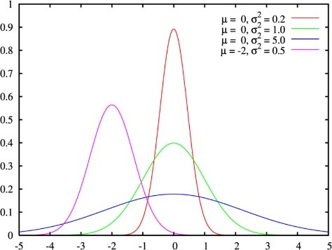
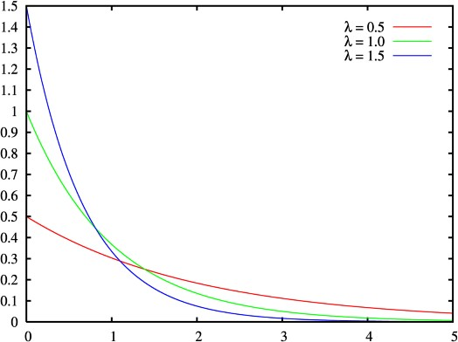
Choice of probability distribution
Fixed
Can be used to approximate cases where the activity processing time varies very little
Example: a task performed by a software application
Normal
Repetitive activities
Example: “Check completeness of an application”
Requires us to specify the mean and the std deviation
Exponential
Complex activities that may involve detailed analyses or decisions
Example: “Assess an application”
Requires us to specify the mean only

Slide 71
Simulation Example
Normal(10m, 2m)
Normal(10m, 2m)
0m
Exp(20m)
Normal(20m, 4m)
Normal(10m, 2m)

Slide 72
Elements of a simulation model
Processing times of activities
Fixed value
Probability distribution
Conditional branching probabilities
Arrival rate of process instances and probability distribution
Typically, exponential distribution with a given mean inter-arrival time
Arrival calendar, e.g., Monday-Friday, 9am-5pm, or 24/7

Slide 73
























Branching probability and arrival rate
Arrival rate = 2 applications per hour Inter-arrival time = 0.5 hour Exponential distribution
From Monday-Friday, 9am-5pm
0.3
0.7
0.3
35m
55m
9:00
10:00
11:00
12:00
13:00
13:00

Slide 74
Elements of a simulation model
Processing times of activities
Fixed value
Probability distribution
Conditional branching probabilities
Arrival rate of process instances and probability distribution
Typically, exponential distribution with a given mean inter-arrival time
Arrival calendar, e.g., Monday-Friday, 9am-5pm, or 24/7
Resource pools
59

Slide 75


Resource pools
Name
Size of the resource pool
Cost per time unit of a resource in the pool
Availability of the pool (working calendar)
Examples:
Clerk
€ 25 per hour
Mon-Fri, 9am-5pm
Credit Officer
€ 35 per hour
Mon-Fri, 9am-4pm

Slide 76
Elements of a simulation model
Processing times of activities
Fixed value
Probability distribution
Conditional branching probabilities
Arrival rate of process instances and probability distribution
Typically, exponential distribution with a given mean inter-arrival time
Arrival calendar, e.g., Monday-Friday, 9am-5pm, or 24/7
Resource pools
Assignment of tasks to resource pools
61

Slide 77


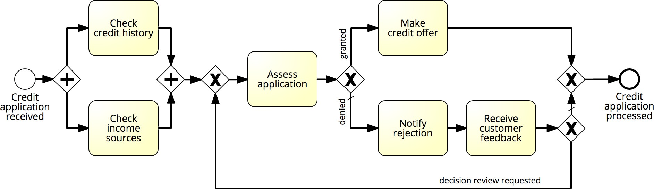

Resource pool assignment
Clerk
Officer
System
Officer
Clerk
Officer

Slide 78

Process Simulation
Define a simulation scenario
Model the process
Run the simulation
Repeat for alternative scenarios
Analyze the simulation outputs

Slide 79
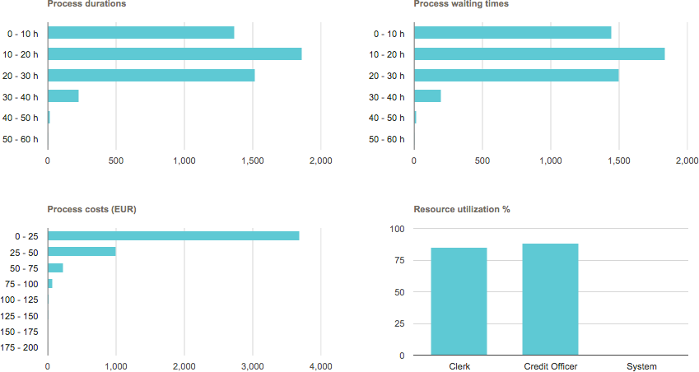
Output: Performance measures & histograms

Slide 80
Process Simulation
Define a simulation scenario
Model the process
Run the simulation
Repeat for alternative scenarios
Analyze the simulation outputs

Slide 81
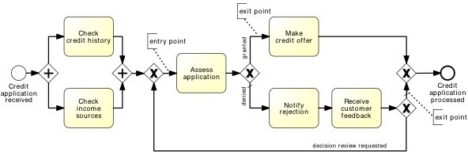
Demo: Simulation in BIMP
https://bimp.cs.ut.ee/simulator/trial?sample=credit_card_application

Slide 82
Pitfalls of simulation
Stochasticity
Data quality
Simplifying assumptions

Slide 83




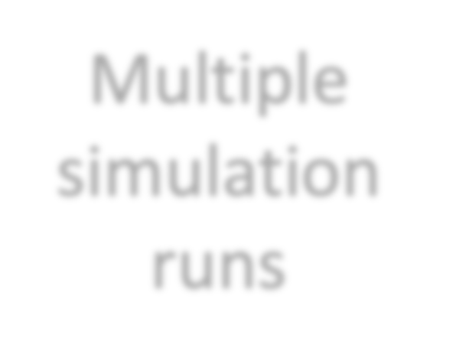



Stochasticity
Problem
Simulation results may differ from one run to another
Solutions
Make the simulation timeframe long enough to cover weekly and seasonal variability, where applicable
Use multiple simulation runs, average results of multiple runs, compute confidence intervals
Average results of multiple runs
Multiple simulation runs
Compute confidence intervals

Slide 84
Data quality
Problem
Simulation results are only as trustworthy as the input data
Solutions:
Rely as little as possible on “guesstimates”. Use input analysis where possible:
Derive simulation scenario parameters from numbers in the scenario
Use statistical tools to check fit the probability distributions
Simulate the “as is” scenario and cross-check results against actual observations

Slide 85
Simulation simplifying assumptions
That the process model is always followed to the letter
No deviations
No workarounds
That a resource only works on one task
No multitasking
That if a resource becomes available and a work item (task) is enabled, the resource will start it right away
No batching
That resources work constantly (no interruptions)
Every day is the same!
No tiredness effects
No distractions beyond “stochastic” ones

